Slide 1



Yousef Torman Managing Director ASREN

Slide 2
Who is the Crucial?
Science Cooperation is Crucial for Development, e.g. UN-SDGs
Digital Infrastructure is Crucial for Science Cooperation
Research & Education Networks are Crucial for the Crucials

Slide 3

What are Research & Education Networks?
Research & Education networks are non-commercial dedicated networks connecting the Universities, Schools, Research Centers, Hospitals, Museums and any other institution that may have research and education activities.
National Research and Education Networks (NRENs) are established to provide connectivity and communications services for the research and education communities at the national level
Regional Research and Education Networks (RRENs) are connecting the NRENs to provide connectivity and services to researchers and educators across the boarders.
Altogether are considered as the Global Research and Education Network (GREN)

Slide 4

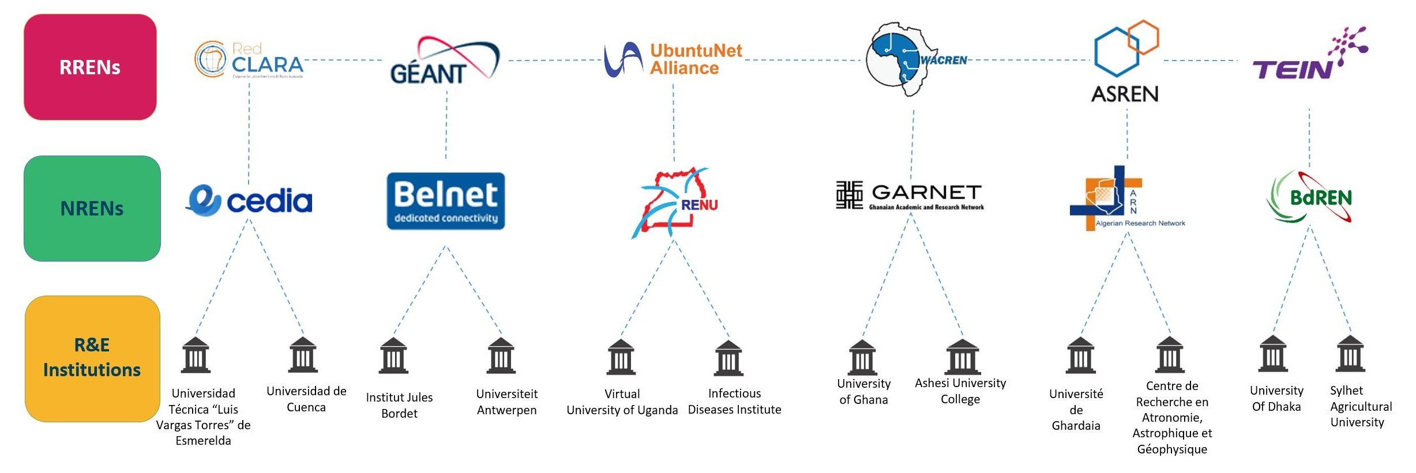
NRENs, RRENs and GREN
GREN
4

Slide 5
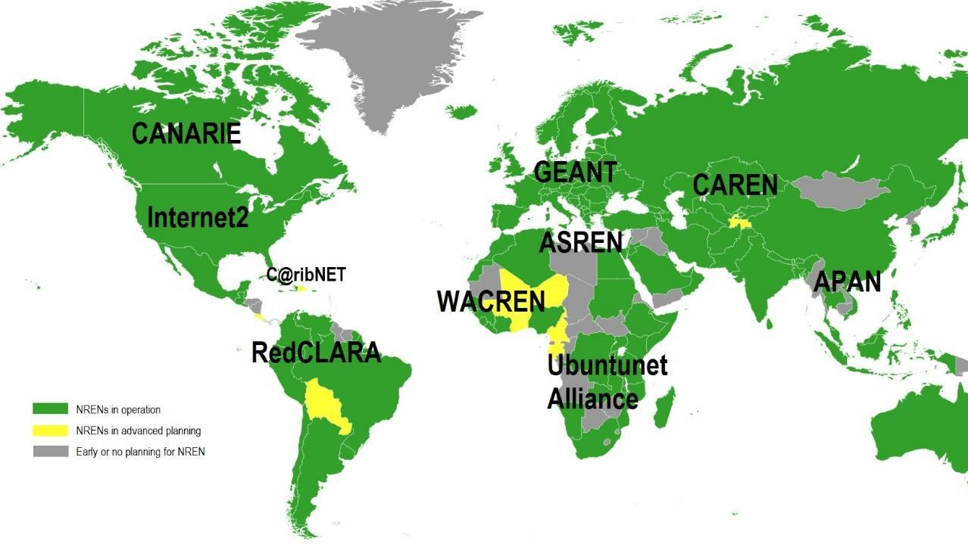
NRENs RRENs Around the World
5

Slide 6
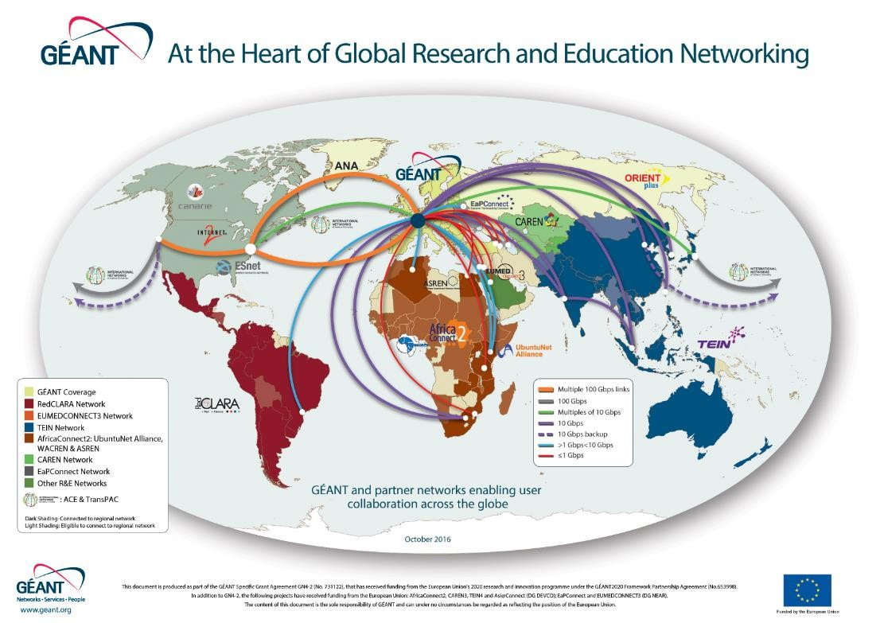
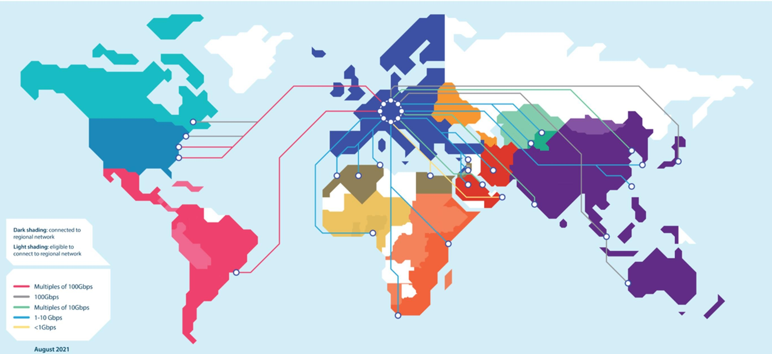

Slide 7
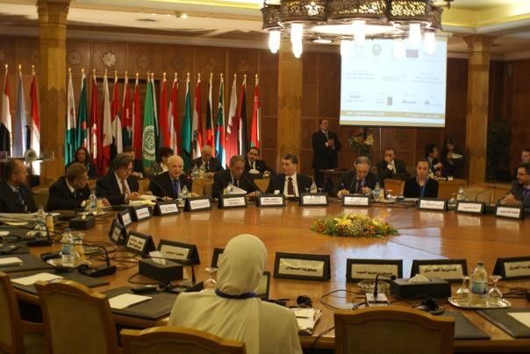
ASREN
Arab States Research and Education Network (ASREN), is a legal non for profit organization with Arab NRENs as shareholders for promoting world-class Pan-Arab e- Infrastructures and E-services for the R&E communities to boost Scientific Research and regional Cooperation
Vision: Pan-Arab collaborative research and education projects and activities, contribute to boost the scientific research, innovation and education levels in the Arab countries by uplifting efficiency and productivity of research and education communities.
Mission: To implement, manage and extend sustainable Pan-Arab e-Infrastructures dedicated for the Research and Education communities and to boost scientific research and cooperation in member countries through the provision of world-class e- Infrastructures and e-services.
Launched at LAS in Cairo December 2010, Under the Patronage of LAS S.G
Endorsed by LAS, European Commission, AArU, FASRC and AICTO and more
Honorary Chaired by HE Secretary general of League of Arab States
Officially Registered in Germany as non for profit company GmbH
asrenorg.net
7

Slide 8
ASREN Objectives
Build, maintain and consolidate regional e-Infrastructures dedicated to e-Science and education across the Arab countries:
  Developing, managing and operating a regional network that interconnects the NRENs of the Arab countries.
  Promoting harmonization of policies and standards in relevant areas at a regional level.
  Advocating/lobbying at the regional level amongst decision makers and stakeholders
Contribute to creating and sustaining NRENS:
  Supporting NRENs to implement leading-edge technological solutions while pursuing cost- effectiveness
  Favoring exchange of expertise and best practices amongst NRENs’ personnel in the region
Facilitate collaboration and cooperation among researchers and academics:
  Increasing availability and accessibility to knowledge resources
  Promoting development of scientific and cultural content in Arabic
  Facilitating knowledge exchange and transfer processes across the region and worldwide
  Promoting the adoption and usage of e-Infrastructures and services among the scientific
community
  Strengthening regional partnerships and encouraging joint scientific research
asrenorg.net

Slide 9
Areas of Intervention
Dedicated Research and Education Networks at national, regional and global levels
→Network Management and Monitoring, Network Security, PerfSonar, MANRS. …
Research and Education Services
→Educational roaming → eduroam, Federated Access through eduGAIN
Science Cooperation
→UN-SDGs through science, Open Science, Open Access, OER, Open Science Platforms, Science Diplomacy
Community Engagement
→Science Communities and Communities of Practice, R&E Communities, Technical
Communities
Scientific Computing
→HPC, Clouds, Grids
Internet Access, Security and Governance
....
asrenorg.net

Slide 10
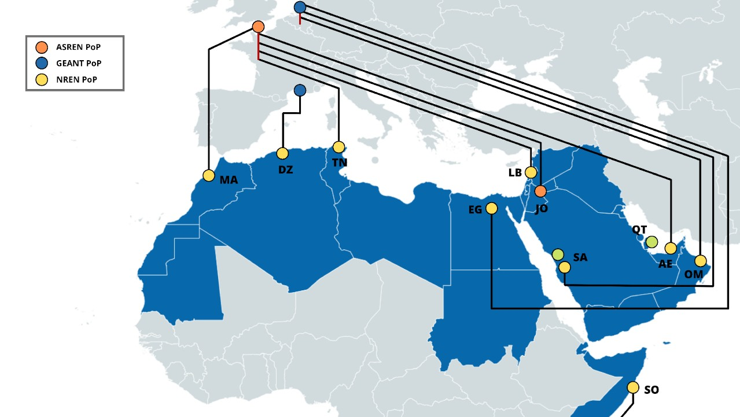



asrenorg.net

Slide 11




Slide 12

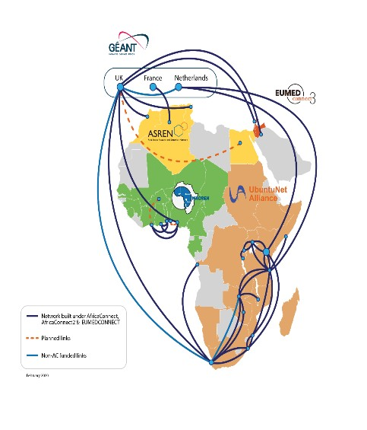

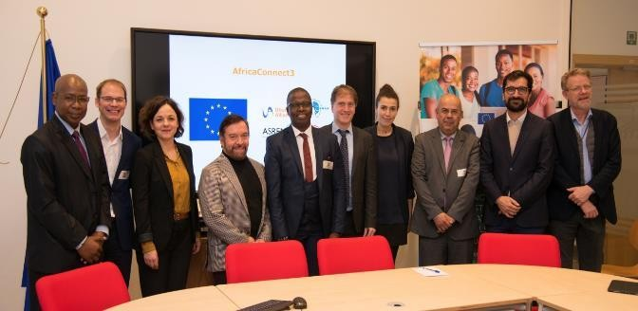




Start date: 16 November 2019
Duration: 48 months
Funds: European Union Grant Contract Budget: 37.5M EUR (80% EU co-funding)
Funding for connectivity, equipment and cloud
The AfricaConnect3 project receives funding from the European Union under Grant Contracts DCI-PANAF/2019/411- 583/584/585/586

Slide 13

NRENs in Africa
Three Regional R&E Networks in Africa
  UbuntuNet Alliance → South and East Africa
  WACREN: → West and Central Africa
  ASREN: → North Africa
NRENs in Africa:
  UbuntuNet Alliance: Burundi, DRC, Kenya, Malawi, Mozambique, Rwanda, Somalia, South
Africa, Tanzania, Uganda, Zambia and Zimbabwe.
  WACREN: Ghana, Nigeria and Togo, Benin, Burkina Faso and Côte d’Ivoire.
  ASREN: Algeria, Egypt, Morocco and Tunisia.
13

Slide 14
AfricaConnect 3 Activities and Work Packages
WP 1 – Expand and Upgrade Research and Education Network and e-Infrastructures
WP 1.1
WP 1.2
WP 1.3
Maintenance and Management of Regional Network Expansion and Upgrade of Connectivity for NRENs Cloud-based e-Infrastructure for African Open Science
WP 2 - Development of R&E Services and Applications
WP 2.1
WP 2.2
WP 2.3
WP 2.4
Service Outreach and Deployment Support
Trust and Identity Services, eduroam….
Proactive Cybersecurity for NRENs and their Digital Assets
Federated Identity Management for Libraries
africaconnect3.org

Slide 15
AfricaConnect 3 Activities and Work Packages
WP 3 – Research and Education Networks Capacity Building
  WP 3.1 Governance and Systems Review of UA, WACREN and ASREN
  WP 3.2 Sustainability Plan
  WP 3.3 Sharing of Best Practices between NRENs
  WP 3.4 Capacity Building under the Africa Training Initiative
  WP 3.5 Women Empowerment in the African NREN community
africaconnect3.org

Slide 16
AfricaConnect 3 Activities and Work Packages
WP 4 - Advocacy for the role of digital tools in the transformation of Education and Research
  WP 4.1 Advocacy and Donor Engagement
  WP 4.2 REN and User Engagement Conferences
  WP 4.3 Engagement with User Communities
  WP 4.4 Project Visibility and Dissemination
africaconnect3.org

Slide 17
AfricaConnect3 Enables Science Cooperation
Providing connectivity between research and education communities
Providing mobility services, namely: eduroam, eduGAIN, eduVPN ….
Providing clouds infrastructures and services
Supporting Open Science through the LIBSENSE project
Engagement with research and education communities
  AfriGEO → African Group on Earth Observation
  GMES and Africa → Global Monitoring and Environment Security
  AERAP → African European Radio Astronomy Partnership
  DEA → Digital Earth Africa
  ASFAP → African Strategy fo Fundamental and Applied Physics
  AfLS → African Light Source Community
  Identifying communities on Climate Actions
africaconnect3.net
17

Slide 18

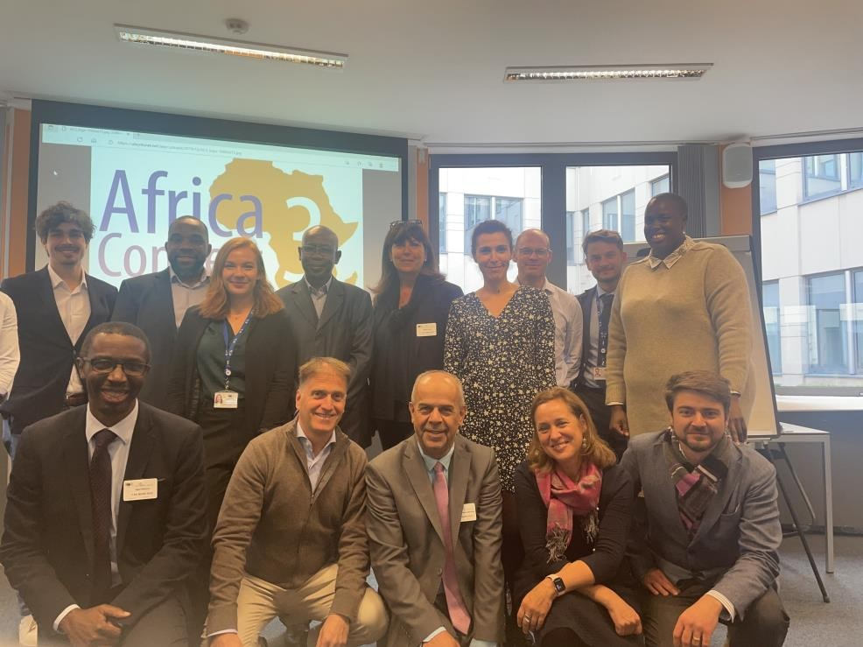





Now Brainstorming AfricaConnect4? 2025-2029
ASREN’s Focus
→ Infrastructures & Connectivity
→ Science Cooperation
→ Open Science & Open Access
→ Open Science Cloud
→ Community Engagement
→ Capacity Building
18

Slide 19
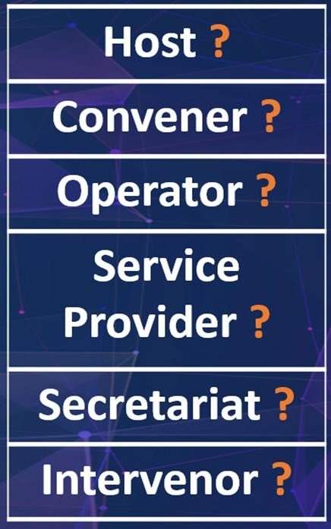
Observations, Global Trends, Priorities, SDGs ……
Climate Actions, Earth Observation, Health Care, Internet Governance…
UN SDGs → Science, Research, Education, Community Engagement
Science and Science Diplomacy
Open Science, Open Access, Open Data….
Science Communities and Communities of Practice
Scientific Computing
Science Collaboration Platforms
Internet Access, Security and Governance
This is a call for a new role/engagement of NRENs
asrenorg.net
19

Slide 20
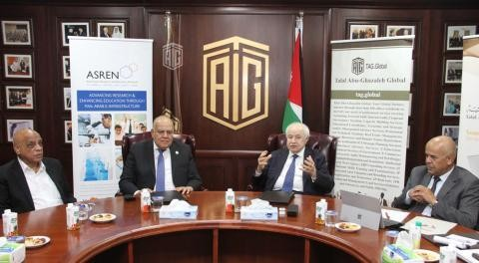
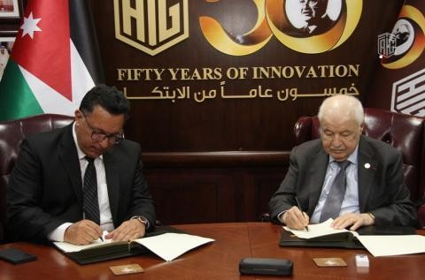



Memorandum of Collaboration Including Open Science
Discussions with UNESCO
20

Slide 21


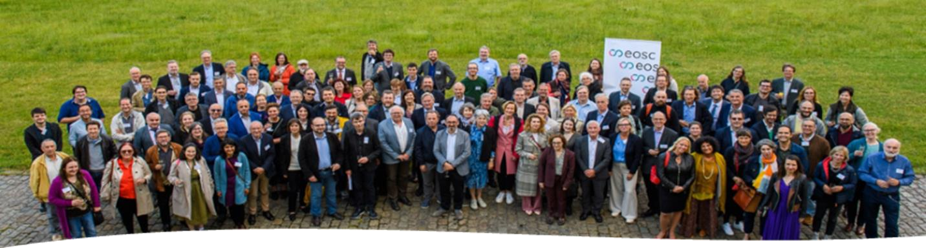

ASREN recognized by Regional OS Clouds and Platforms
ASREN is Official Observer with EOSC and Contributes to Several Task Forces
ASREN was part of the planning process, mainly the for infrastructures component
Good Cooperation with National Initiatives for Open Science in Europe
21

Slide 22
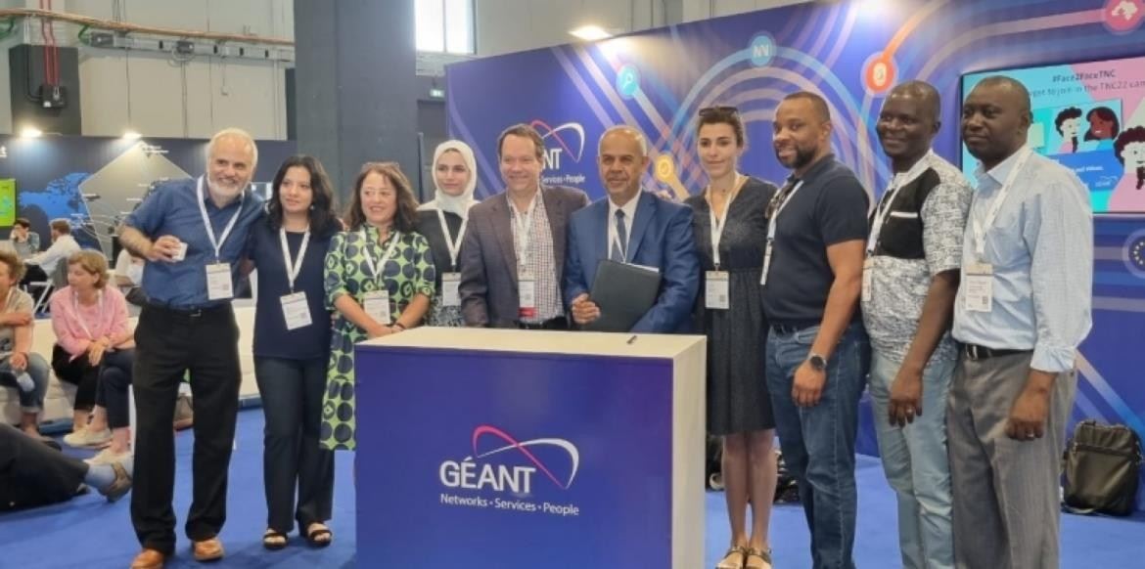


ASREN to start its Regional Harvesting Services
LA Referencia and ASREN worked together in a pilot experience using LA Referencia software platform:
  harvesting and validating samples of Arabic repositories
  knowledge sharing and technical meetings
  evaluating the software as an alternative for building services
The pilot was very successful, and both learned
a lot in the process.
→ Deployment agreement signed in June during TNC22
asrenorg.net

Slide 23

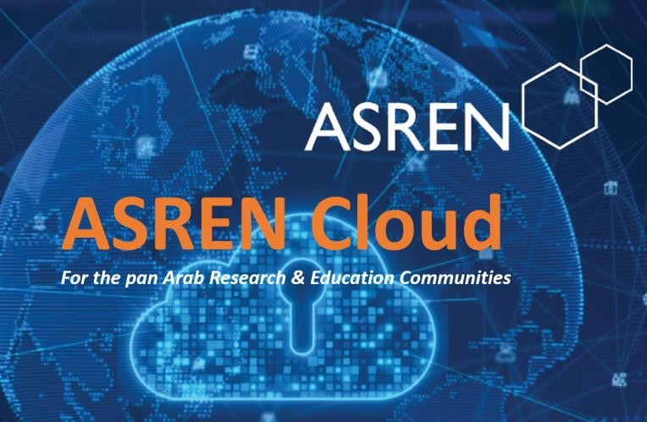





Cloud Debate (Planstorming)
asrenorg.net

Slide 24
ASREN Calls for Science Dialogue
Science Cooperation and Societal development to advance progress towards achieving the UN SDGs
Open Science, Open Access and Open Data
Open Science Cloud as effective means to enhance science collaboration → Arab States Open Science Cloud (ASOSC)
Regional and Global Science Communities to foster growth

Slide 25
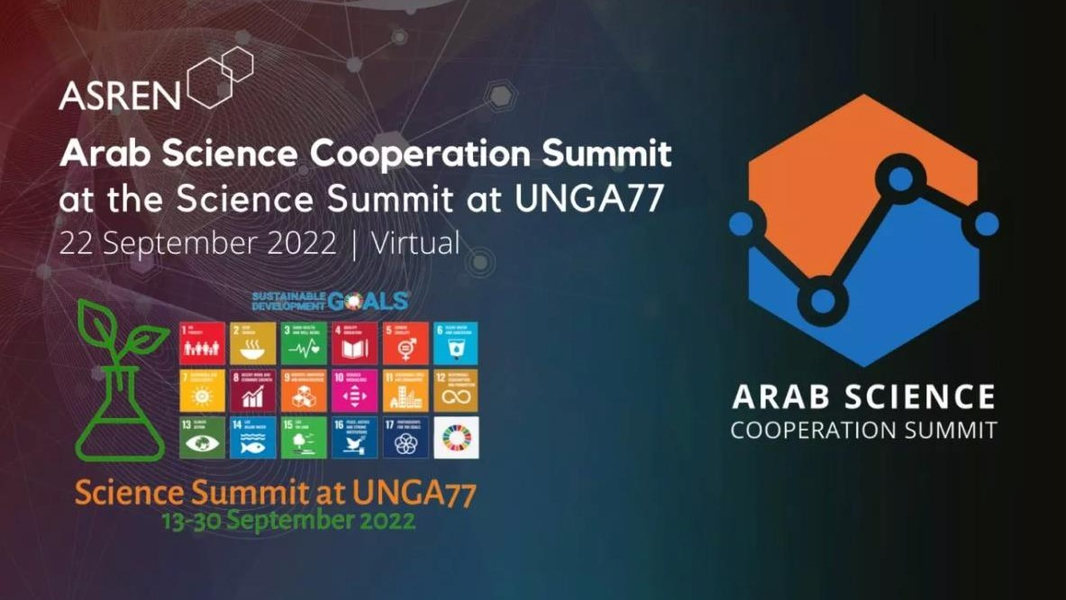

Slide 26
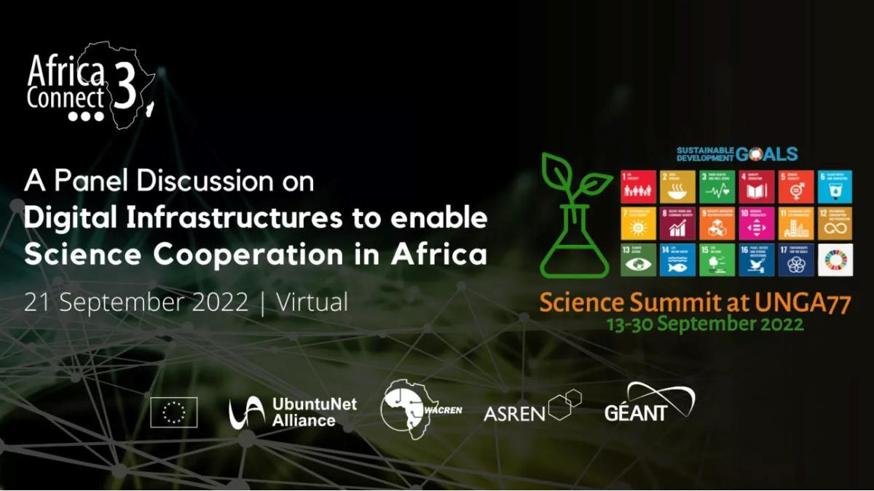
2
6

Slide 27

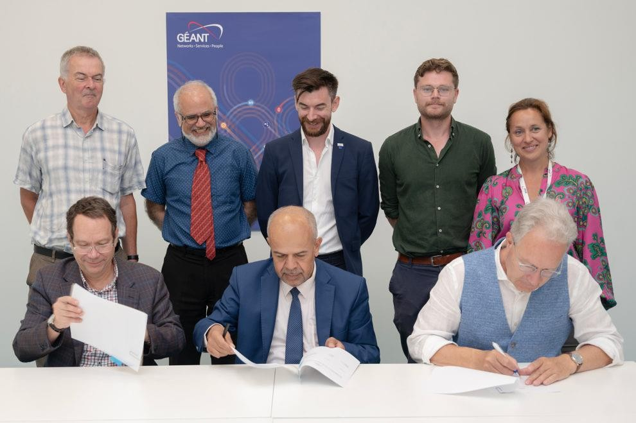



Katowice Declaration
Increased Collaboration to support Earth Observation efforts

Slide 28
Katowice Declaration
A rapid and fluid exchange of data, information and knowledge among researchers worldwide is an important facilitator of scientific progress.
It is noted that technical challenges exist regarding the synchronisation of platforms that support GEOdata transfer within and between continents, which requires further work to resolve. This includes the need to increase technical capacity.
Human capacity building within and between NRENs and RENs on this subject should be supported.
The Parties recognise the need for increased engagement with end-user communities that produce and digest GEO-data. It is recognised that a proportion of GEO-data end-user communities are unaware of the technology that can be provided by NRENs and RENs for their research and education needs.

Slide 29
Katowice Declaration again
Open access policies need to be formed and adopted in line with the UNESCO Recommendation on Open Science
The Parties recognise the diversity of research priorities for end-researcher communities. This requires a better effort from RENs and NRENs to understand research priorities for each continent and identify areas of overlap in order for more effective collaboration.
RENs and NRENs have a role to increase digital literacy where this subject allows, especially when increasing the level of digital literacy for women active in the GEO ecosystem.
RENs and NRENs should also be involved in governance efforts in areas where GEO communities are also active. Cooperation between RENs has already begun in this area.

Slide 30
Again, Katowice Declaration
A global research and education network (GREN) is something that would greatly enable both the technical and human capacity building noted in points II. and III.
Enhancing the effectiveness of research along the GEO ‘chain’ will be essential in order to fully exploit the value of geospatial data. This can be done by regularly upgrading infrastructure and technology to meet the present-day requirements of end-user communities.
RENs and NRENs provide the mechanisms that enable the realisation of many of the United Nations’ Sustainable Development Goals. Collaboration with GEO- communities will be a vital example (and potential metric) to measure REN and NREN contributions here.
REN and NRENs should baseline where they already are regarding the Sustainable Development Goals. This includes the need to understand the level of open science usage in different world regions.

Slide 31



Slide 32




Thank you
Any questions?
@ASRENO
rg
@ASRENOrg
asrenorg.net

